Slide 1
Designing Work Organizations
Session 1 & 2
Prof. Parijat Lanke

Slide 2
What is an Organization?

Slide 3
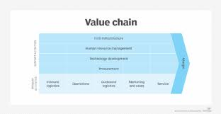
Value Creation
Inputs
Process
Environment
Output

Slide 4
Why Do they Exist?
Common and Explicitly Defined Goal? Really?
Cooperation ?
Efforts < Pay ?
Contracts:
Spot Market Contract
Contingent Claim Contract
Sequential Spot Contracting
Transaction Costs
Market
Bureaucracy
Clans

Slide 5
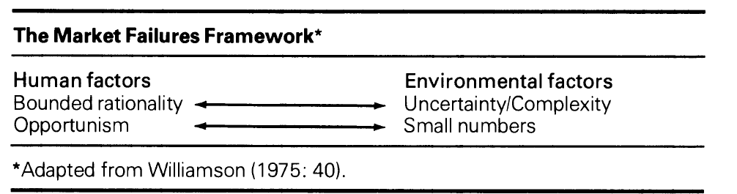
Why Do Market’s Fail?

Slide 7
What does Jones Say, Why Org. Exist?
To Increase Specialization and Division of Labor
To use Large Scale Technology
Manage the External Environment
Economize on Transaction Costs
Exert Power and Control

Slide 8
What is Organization Theory?
The study of how organizations function and how they affect and are affected by the environment in which they operate.
Gaining Competitive Advantage
Ability to outperform competitors by value creation and resource management

Slide 9
Transaction Costs and the Choice for it!
Why and When do organizations be OK with higher transaction costs or rather transact in a market vis a vis within the company?
Type of Assets
Degree of Uncertainty
No. of Exchange Partners
Which mechanisms come to your mind when managing Transaction Costs?
1. Outsourcing
2. Franchising
3. Keiretsu

Slide 10
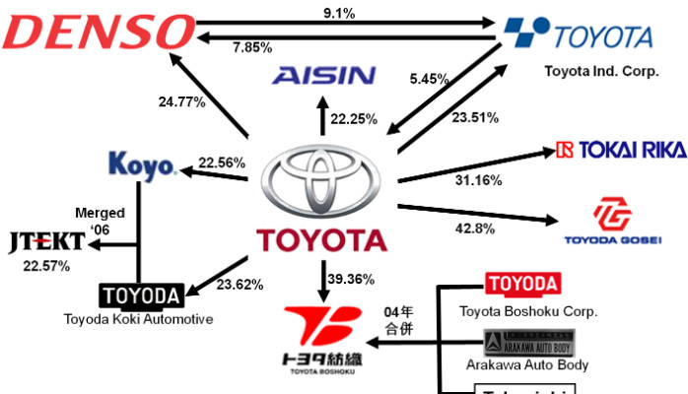

Slide 11
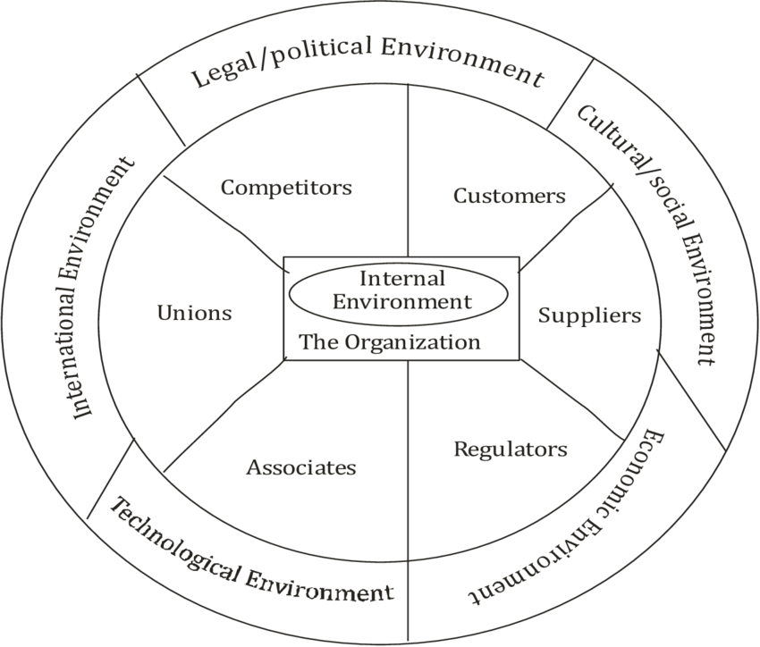
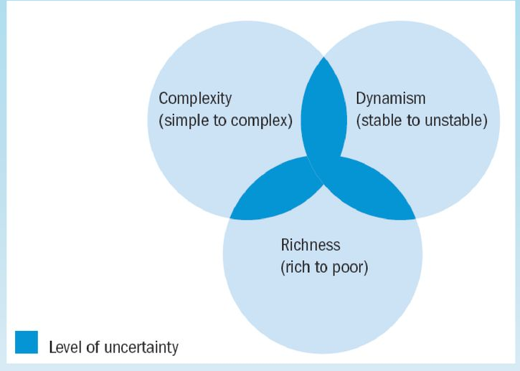
Three Factors of Uncertainty in Environment
Types of Organizational Environment
Open Systems Approach

Slide 12
AGENCY THEORY
Fiduciary Responsibility
Moral Hazard
How To Resolve?
Governance Mechanisms

Slide 13
Imagine a YouTube Channel, How will you measure it’s Effectiveness?
Now Compare it with a B-School

Slide 14
Measuring Effectiveness
External Resource Approach:- Secure, Manage, and Control Scarce And Valued Skills And Resources
Internal Systems Approach:- Ability to be Innovative and Function Quickly And Responsively
Technical Approach:- Converting Skills and Resources into Goods And Services Efficiently

Slide 15
Let’s Discuss the Outline

Slide 16
Why are we all here?

Slide 17
Henry Mintzberg and Org. Design

Slide 18
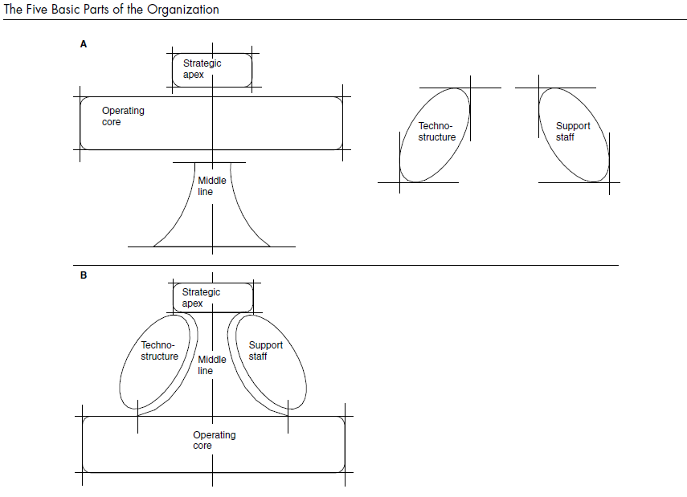

Slide 19
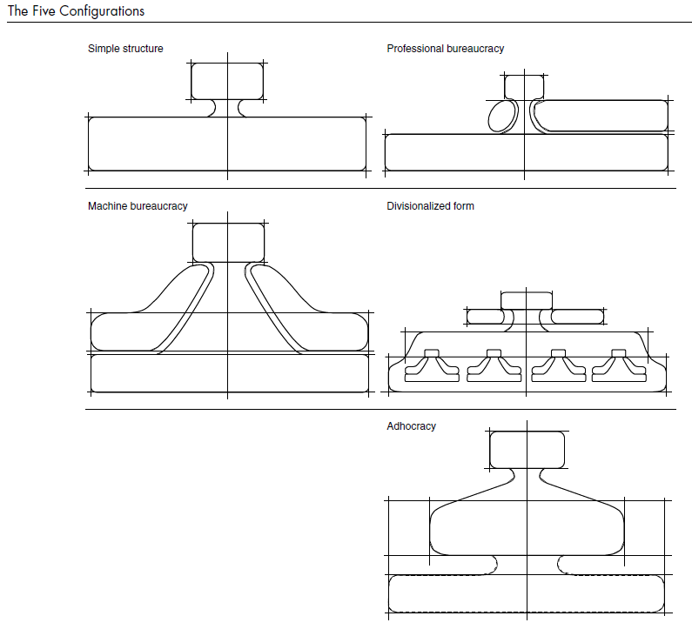

Slide 20
The Design Choices
Differentiation vs. Integration
Mechanistic vs. Organic (environmental uncertainty)
S.O.P. vs. Adjustments

Slide 21
Design Choices
Differentiation & Integration
Centralization & Decentralization
S.O.P. & Mutual Adjustment

Slide 22
Differentiation
Vertical Differentiation
Horizontal Differentiation
Is one better than other?
Problem with Differentiation?

Slide 23
Integration Mechanisms
Hierarchy of Authority
Direct Contact
Liaison Role
Task Force
Team
Integrating Role
Integrating Department

Slide 24
Centralization vs. Decentralization
Who gets to make decisions?

Slide 25
Mechanistic -------------- Organic

Slide 26
Structure Types
Organization/management centric
Crowd centric
Employee centric (https://www.youtube.com/watch?v=tJxfJGo-vkI)
Notes:
https://www.youtube.com/watch?v=tJxfJGo-vkI

Slide 27
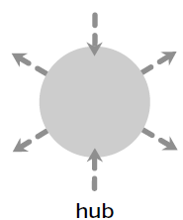
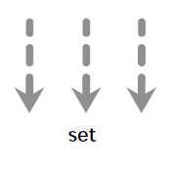
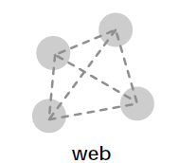
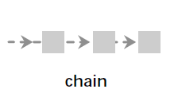
Organigraph

Slide 28
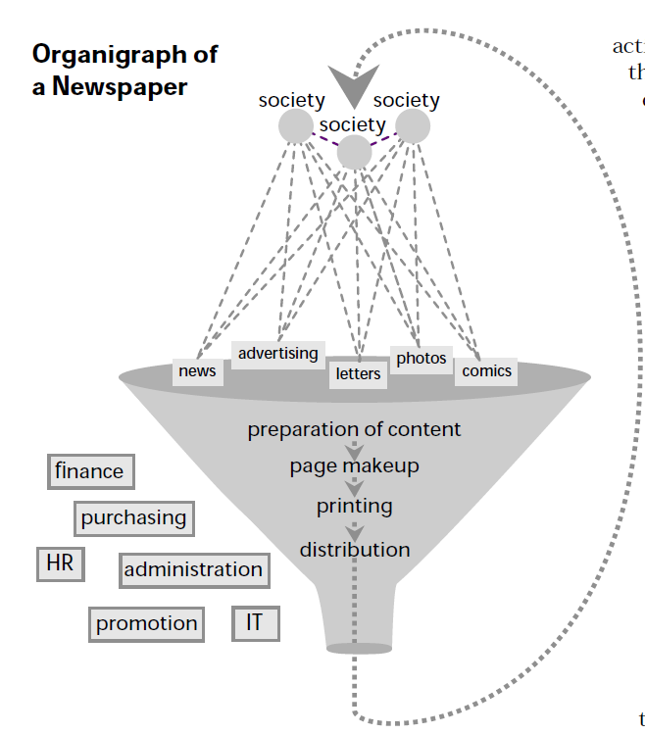

Slide 29
